Slide 1
THE NORTH WESteRN HOUSE PREDICTION PRICES
GROUP 3.2 : Members
Josiah Okumu
Lavender Echessa
Victor Mawira
Mary Wairimu

Slide 2
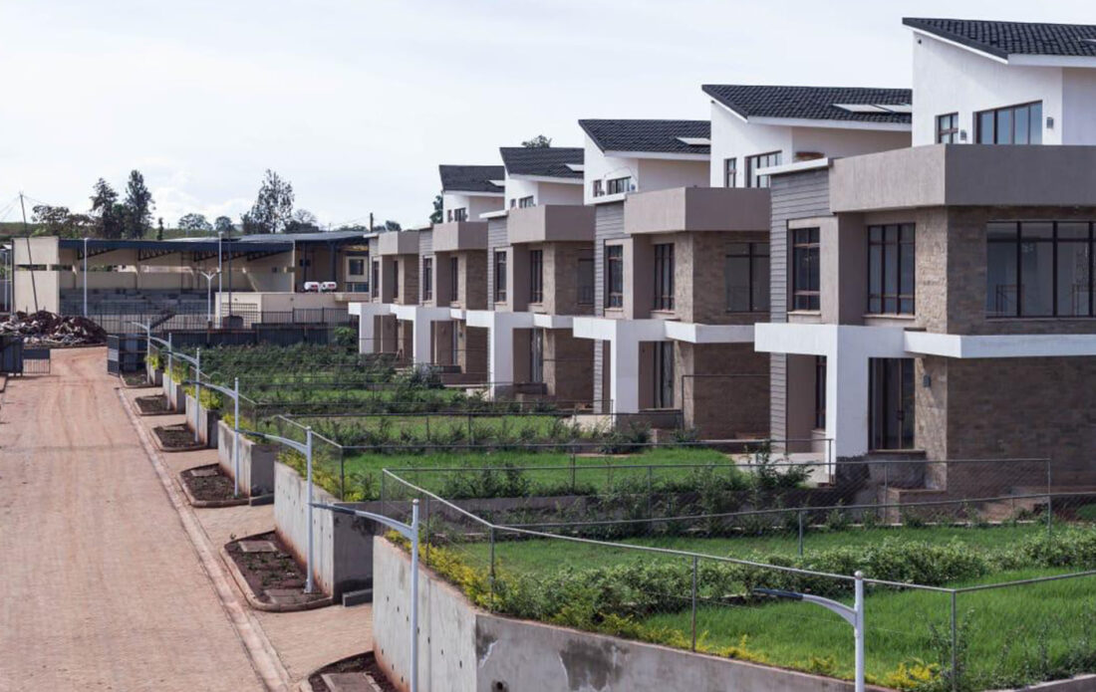
Look No more for
Quality advice!!

Slide 3
BRIEF INTRODUCTION:
House Price prediction are very stressful work as we have to consider different things while buying a house
The structure , rooms ,kitchen ,parking space ,the period/time of purchase/ sale of the houses, bedroom numbers,the house grade,the year it was built , floors and the renovations done.
The Northwestern County housing situation is one that is worth investigating as housing pricing within region is something that cannot be ignored since it affects the majority.

Slide 4
OBJECTIVES:
To identify the factors that affects the prices of homes in Northwestern county
To create a model that can help to predict the price of a house in Northwestern county
The specific objective in this case will be to help homeowners make appropriate decision, on whether renovation affects the property values, hence pricing or whether other factors like bedroom and areas of both house and compounds can as well influence the pricing

Slide 5
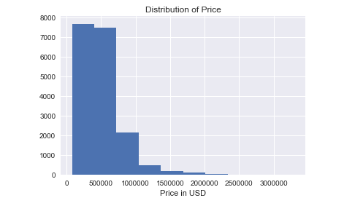
The price distribution
The north eastern county has most of the houses ranging at the
500,000 and 1000000 and relatively few when increasing the prices

Slide 6
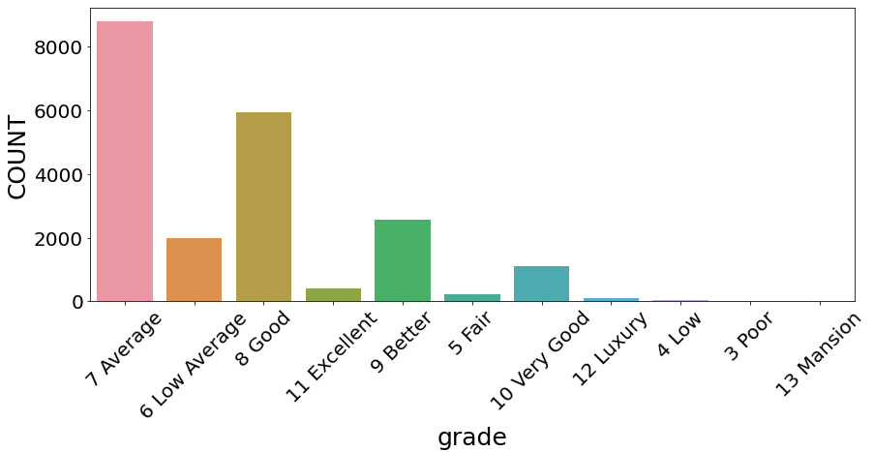
Distribution of grades
the Average grade is seen to be highest followed by Good .Thus showing of that most people not that very pleased

Slide 7
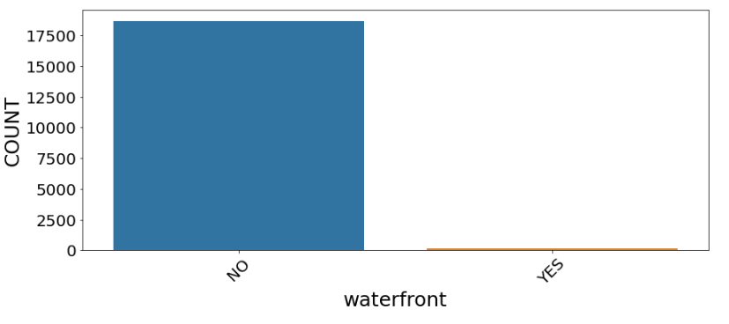
waterfront
Most of the people are seen to not have the waterfronts as demonstated below

Slide 8
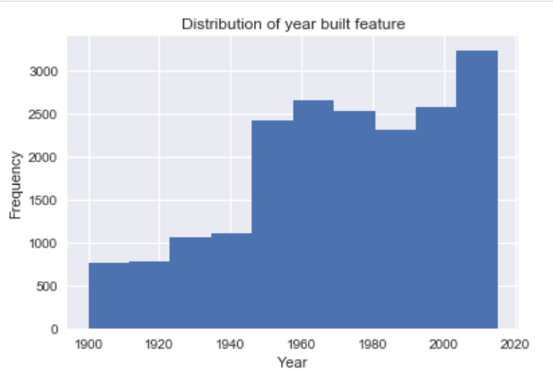
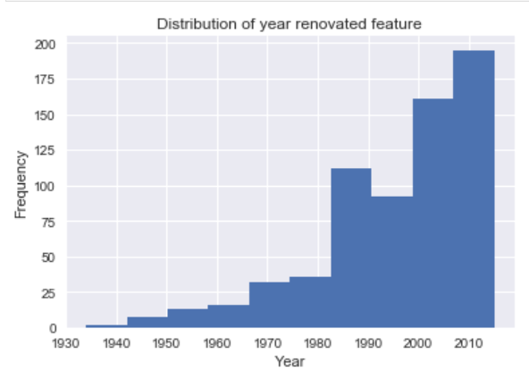
Years distribution
Year built
Most of the buildings are between the 2000 and 2020.And its continuously rising.
Year of renovations:
Most of the houses are seen to be renovated at around the year 2010

Slide 9
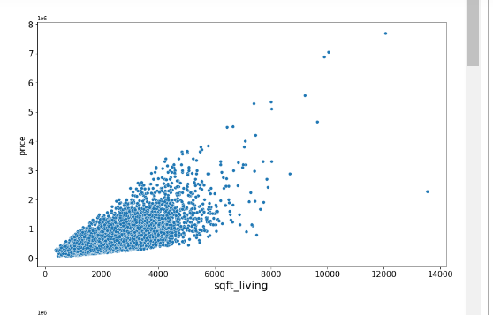
The sqft living
The scatter plot below shows how strongly related the sqft living is related to the price. Thus showing that a change in square feet living strongly affects the price.

Slide 10
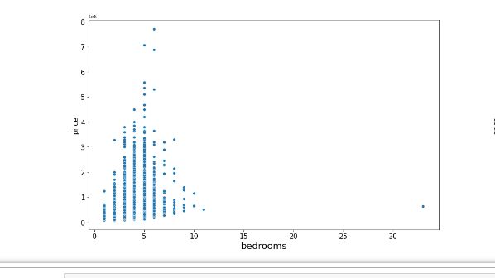
Bedrooms feature
The 5 bedroom houses are seen to seen to sell at high prices compared with the rest .

Slide 11
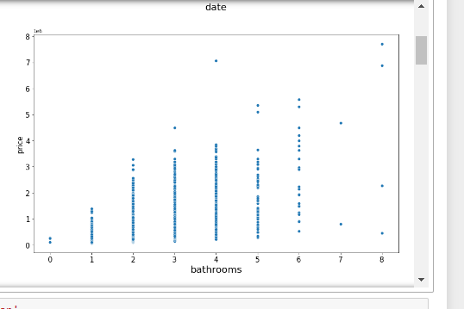
BATHROOMS
The increase in bathroom numbers is seen to cause an increase in the prices as well

Slide 12
CONCLUSION
We can conclude that different factors affects price of houses differently as shown by visualizations above .There is significant relationship between bedrooms , bathrooms, sqft_living, floors, waterfronts, veiw, grade, sqft_above etc that affects the price of housing in the area.

Slide 13
RECOMENDATIONS
Homeowners should consider the following when building; bedroom numbers, bathroom numbers, sqft_ living area, sqft lot,quality of the house, sqft basement, vicinity of the house.
Housing agency should be aware that timing affect the price and should therefore advice homeowners on when to build and sell.
Consider other algorithms beyond multiple linear regression
Consider regression methods that can deal with under or over fitting

Slide 14
THANK YOU
TO THE HOMEOWNERS & AGENCIES HAVE PRODUCTIVE SALES AND RETURNS .

